Slide 1

IntelliRoast
Chaise Farrar · Drake Bolland JR Jamora · Noah Siano Rebecca Siciliano
Notes:
Chaise

Slide 2




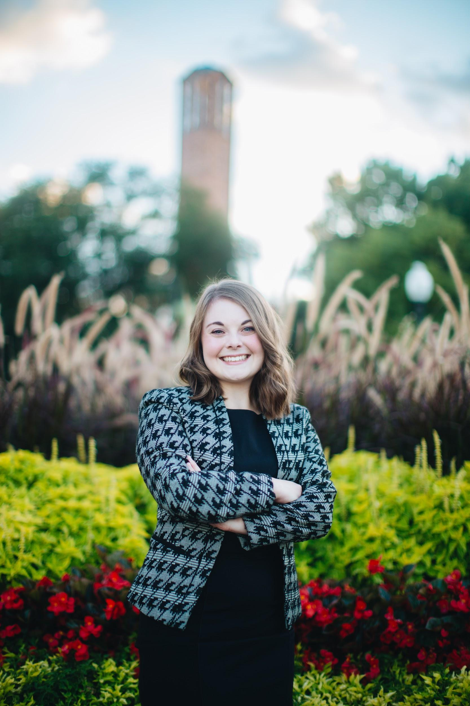
Introduction: Team Members
Chaise Farrar
Computer Engineering
Embedded Design
Team Lead
Drake Bolland
Electrical Engineering
Mechanical Design
Electrical Design
JR Jamora
Electrical Engineering
Thermodynamic Modeling
Electrical Design
Noah Siano
Computer Engineering
Website Development
Application Development
Rebecca Siciliano
Electrical Engineering
Thermodynamic Modeling
Electrical Design
Notes:
Everyone

Slide 3
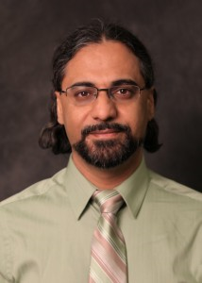
Introduction: Faculty Advisor
Dr. Masoud Karimi
Associate Professor, Mississippi State University
Ph.D., Electrical Engineering, Energy Systems, University of Toronto, Canada, 2004
Power system stability, protection and control
Notes:
Drake
Power system stability, protection and control Power system stability, protection and control Power system stability, protection and control Power system stability, protection and control Power system stability protection and control, Power system stability, protection and control Power system stability, protection and control Power system stability, protection and control Power system stability, protection and control Power system stability, protection and control Power system stability, protection and control, Power system stability, protection and control

Slide 4

Outline
The Problem
The Solution
Constraints
Technical Constraints
Practical Constraints
Engineering Standards
Approach
Problem
Solution
Constraints
Approach
Notes:
JR
Our outline for today is to discuss the problem at hand within the coffee industry and our solution for these problems. We will then discuss how IntelliRoast aims to solve these issues, with an emphasis on our established requirements we are constraining IntelliRoast and the vision set out for IntelliRoast through our approach.

Slide 5



Problem
[1], [2], [3]
Notes:
Chaise

Slide 6


Solution
Notes:
Becca
Roasting your own beans at home is a way of solving this coffee nightmare. By roasting at home, beans are insured to be fresh and roasted to the profile a user wants every time. IntelliRoast is a household kitchen appliance that does just that. It interfaces with an app allowing the user to pick their roasting profile and have a hands free roasting experience at home. To do this we have outlined some constraints on our design.

Slide 7
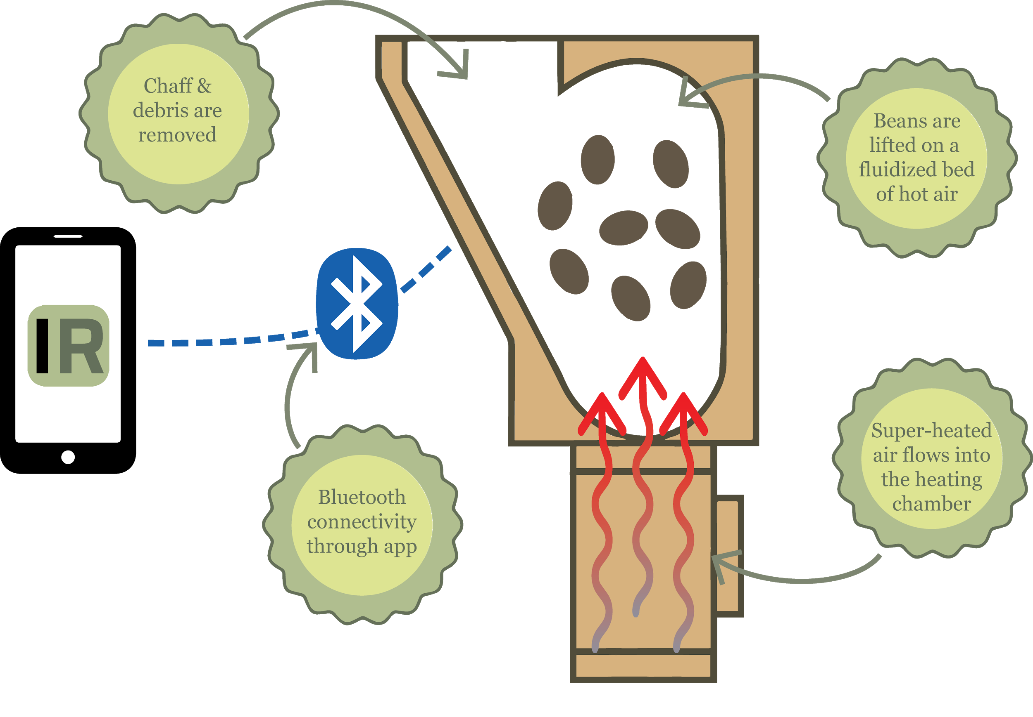
Solution
Notes:
Becca

Slide 8
Technical Constraints
Constraint | Description
Power Draw | Under 15A at 120V
Bean Agitation | Agitate and lift ~120g of beans
Roasting Temperature | At least 300°C
Surface Temperature | Must not exceed 60°C
Wireless Distance | Connect up to 3 meters away [4]
Notes:
Drake

Slide 9
Practical Constraints
Constraint | Description
Economic | Cost less than $500
Hands-Free Usage | Operate without user intervention
App-Enabled | Additional features in smartphone app
Chaff Collection | Collect chaff
Notes:
Noah

Slide 10
Engineering Standards
Standard | Description
ASTM C1055 | The surface temperature must be below 70°C
IEC-60529 | Abide by IP ratings to protect against the intrusion of solid objects and water
Notes:
JR
On top of our established constraints, these are the engineering stanards IntelliRoast will comply. The ASTM standards establish upper temperature limits where the device transitions from “safe to touch” to “first degree burn risk.” The defined standard is 70 C, which is higher than our established 60 C constraint. This was designed to further protect the user from burns.
The IEC standards are in the form of IP ratings, which define the device’s protection from solid objects and water

Slide 11
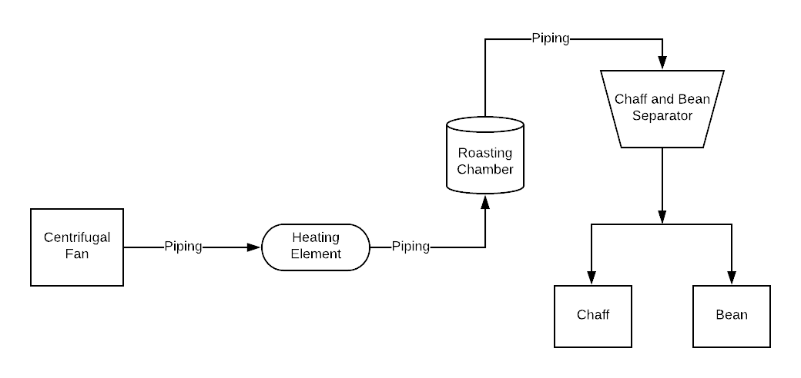
Approach: Mechanical
Notes:
Drake

Slide 12
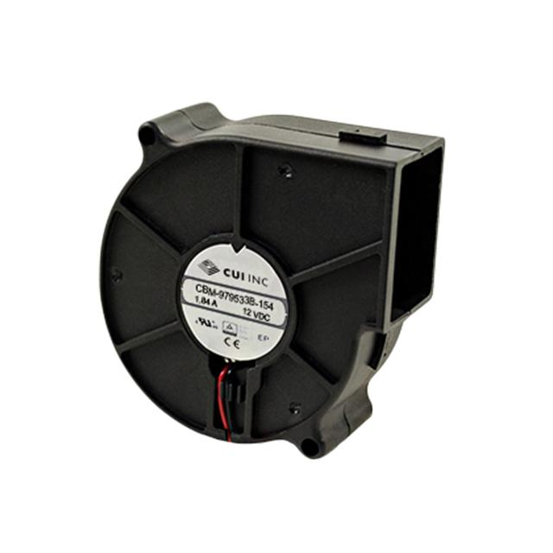
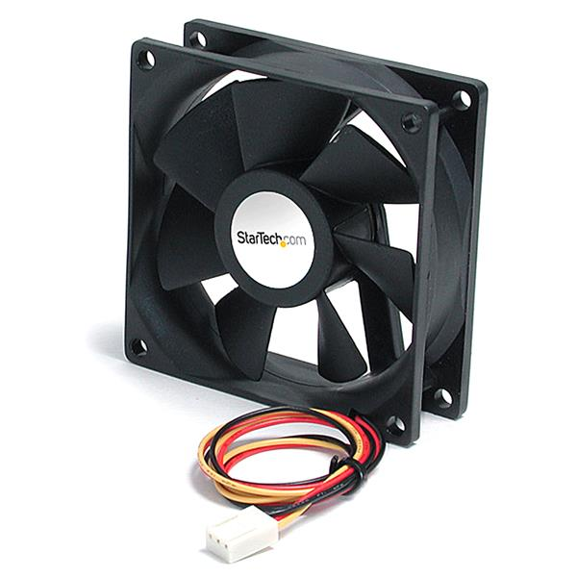
Approach: Fan
Fan S/N | Max Power Input (W) | Max Air Flow (CFM) | Max Static Pressure (inch H₂O) | Price
CBM-979533B-154 | 22.08 | 44.2 | 3.39 | $14.45
CBM-979533B-168 | 48.30 | 54.7 | 5.22 | $18.35
[5], [6]
Notes:
Drake

Slide 13
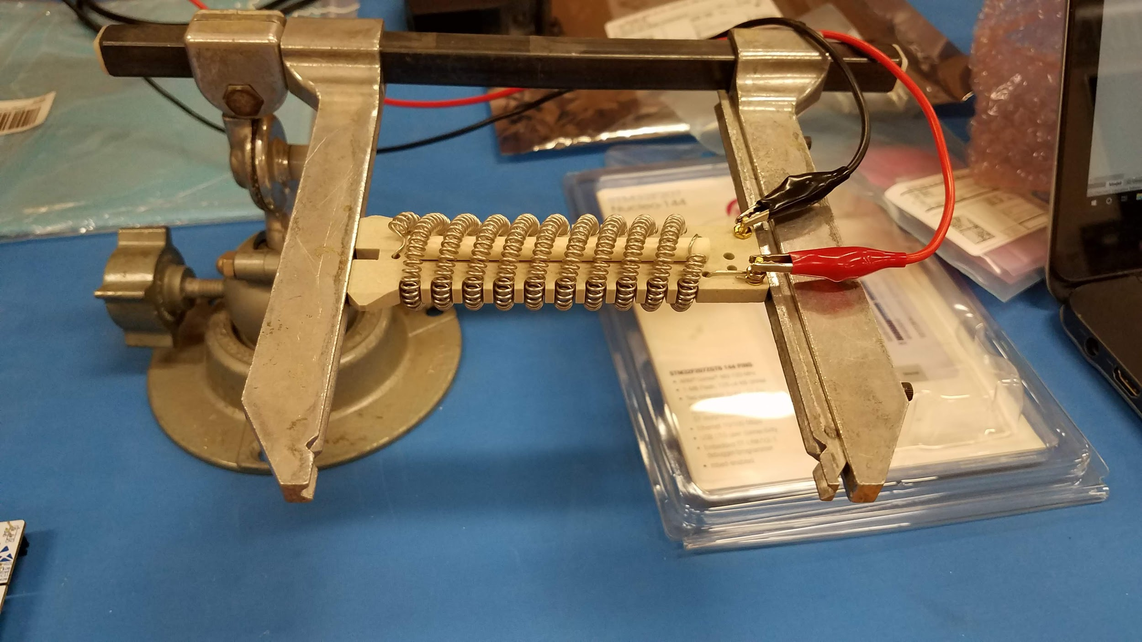
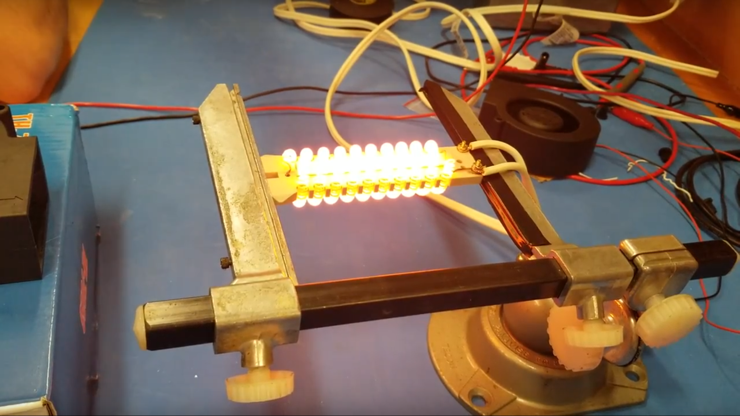
Approach: Heating Element
Element | Price per Unit (USD) | Description | Properties
REPL Heating Element for HG501A | 28.20 | Heating Element | 500°F~700°F (260°C~371°C)
Custom Resistive Wiring | 21.88/32ft | Nickel Chromium wire only | ~1850°F (~1010°C)
Notes:
Becca
To heat the air moved by the fan and roast the beans, we are using a heating element. We considered two possible ways of heating, custom resistive wiring and a pre-coiled heating element. As you can see, both are well within the 300C constraint. Both are made of nickel chromium which provides an even heat distribution. However, custom wiring would require us to coil the wire ourselves, introducing a lack of uniformity. Conversely, The pre-coiled element is uniform in its coil. The precoilded element also comes with data sheets and information provided. We chose this element despite the higher price since a the greater cost does not hinder our design goals.

Slide 14
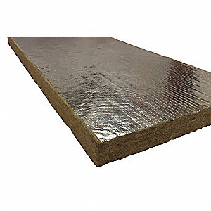
Approach: Insulation
Material S/N | Price (USD) | Description | Dimensions | Properties
ROXUL #40260 | 15.65 | Mineral Wool/Foil Backing High Temperature Insulation | 1” x 48” x 24” | 0°F to 1200°F (-18°C to 649°C)
STI #SSWRED2 | 56.09 | Fire Barrier Wrap Strip | 1.5” x 12’ x 1/8” | Up to 4 hr. Fire Rating
3M #PM4 | 21.11 | Fire Barrier Packing Material | 4” x 20’ 6” x 1/2” | Up to 4 hr. Fire Rating
Fiberglass SKU: 541 | 13.10 | Fiberglass High Temp Tape | 1” x 100’ x 1/16” | Rated up to 1000°F (537°C)
[7]
Notes:
JR
“With great heat comes great responsibility” and IntelliRoast’s insulation is responsible for reducing the surface temperature to “safe to touch” levels. Two major types of insulation exist on the market: Fire barriers and fiberglass-like materials. Fire barriers mainly stop objects from catching on fire, but do not actually reduce high temperatures, so the surface would still be hot-to-touch. We elected to not use the STI or 3M for these reasons. Fiberglass-like materials like mineral wool are made from melted basalt stone and steel slags, which gives insulation properties at high temperatures. We selected ROXUL’s Mineral Wool because the Fiberglass tape is a loose material, which would be able to move around because of its thinness. The ROXUL material allows for heat insulation and its dimensions present an easier method of securing inside IntelliRoast.

Slide 15
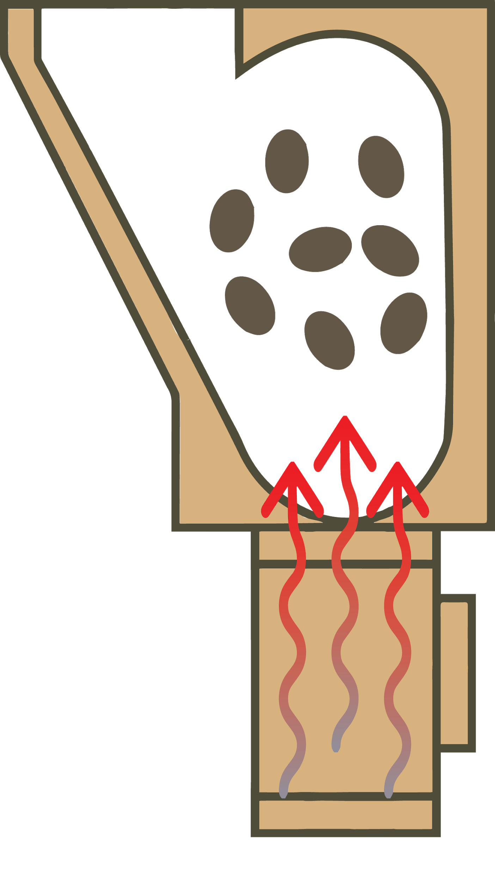
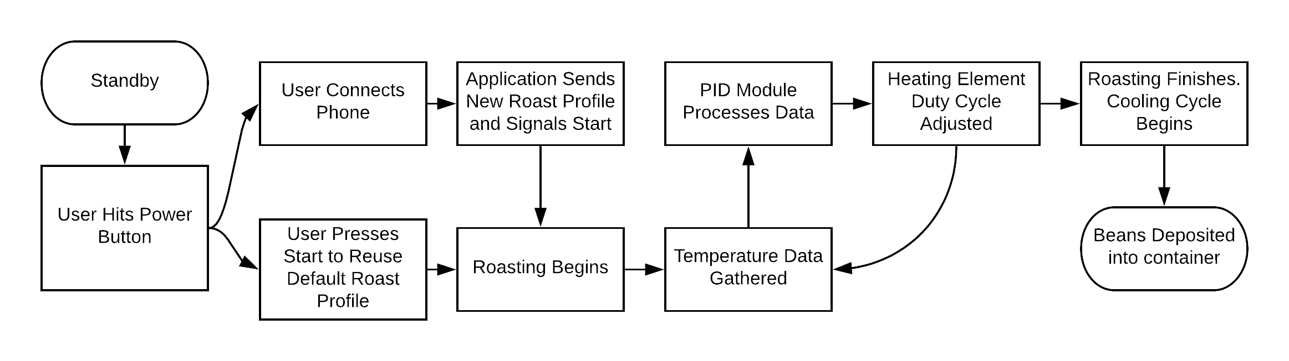
Approach: Control Software
Notes:
Chaise

Slide 16
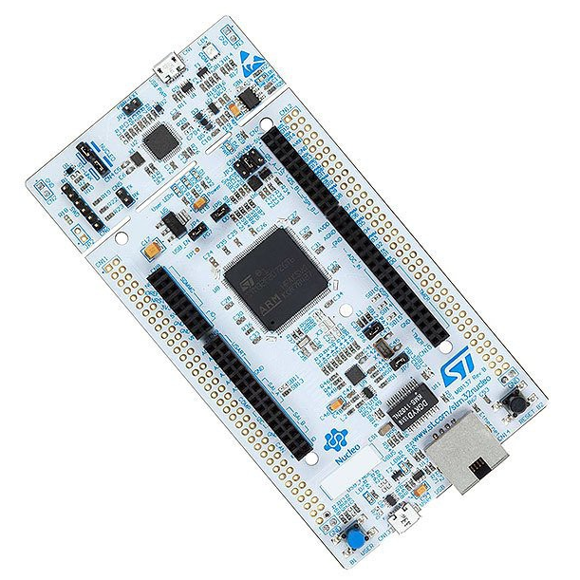
Approach: Microcontroller
MCU | Clock Speed | SRAM | Flash | GPIO Pins | Price
STMicro STM32F207 | 120MHz | 128KB | 1MB | 140 | $12.75
Atmega 328P | 20MHz | 2KB | 32KB | 23 | $2.14
Notes:
Chaise

Slide 17
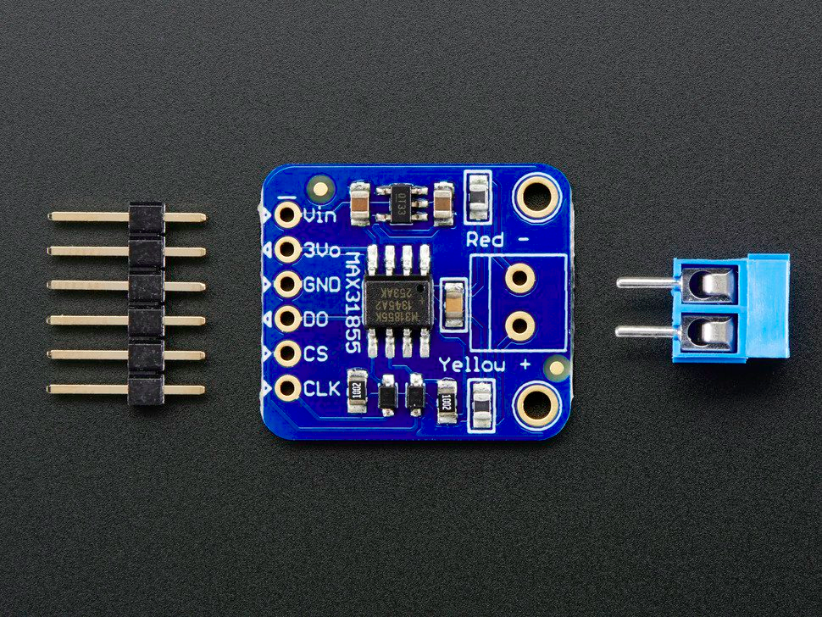
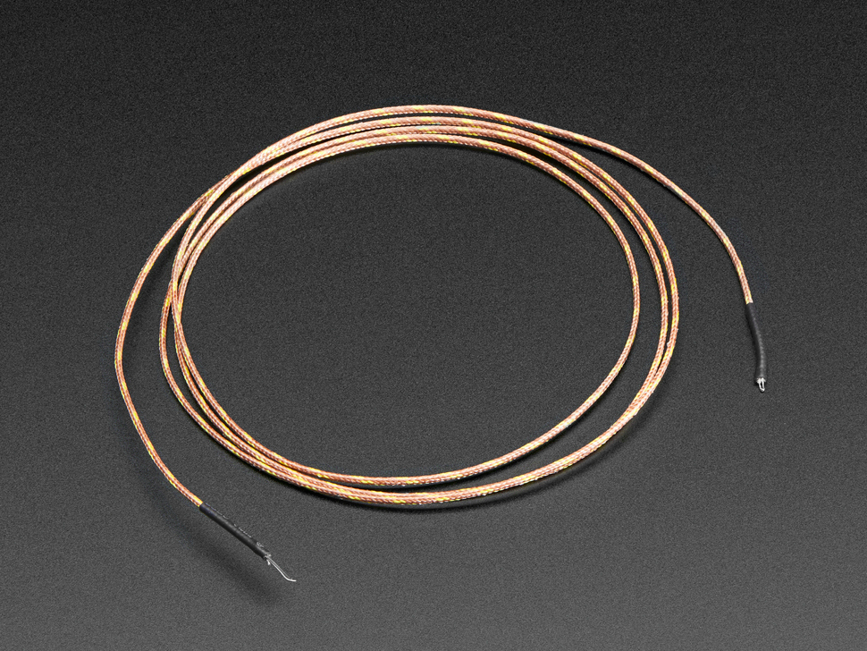
Approach: Temperature Probe
Adafruit MAX31855 breakout
K-Type Thermocouple
[5]
Notes:
Chaise

Slide 18
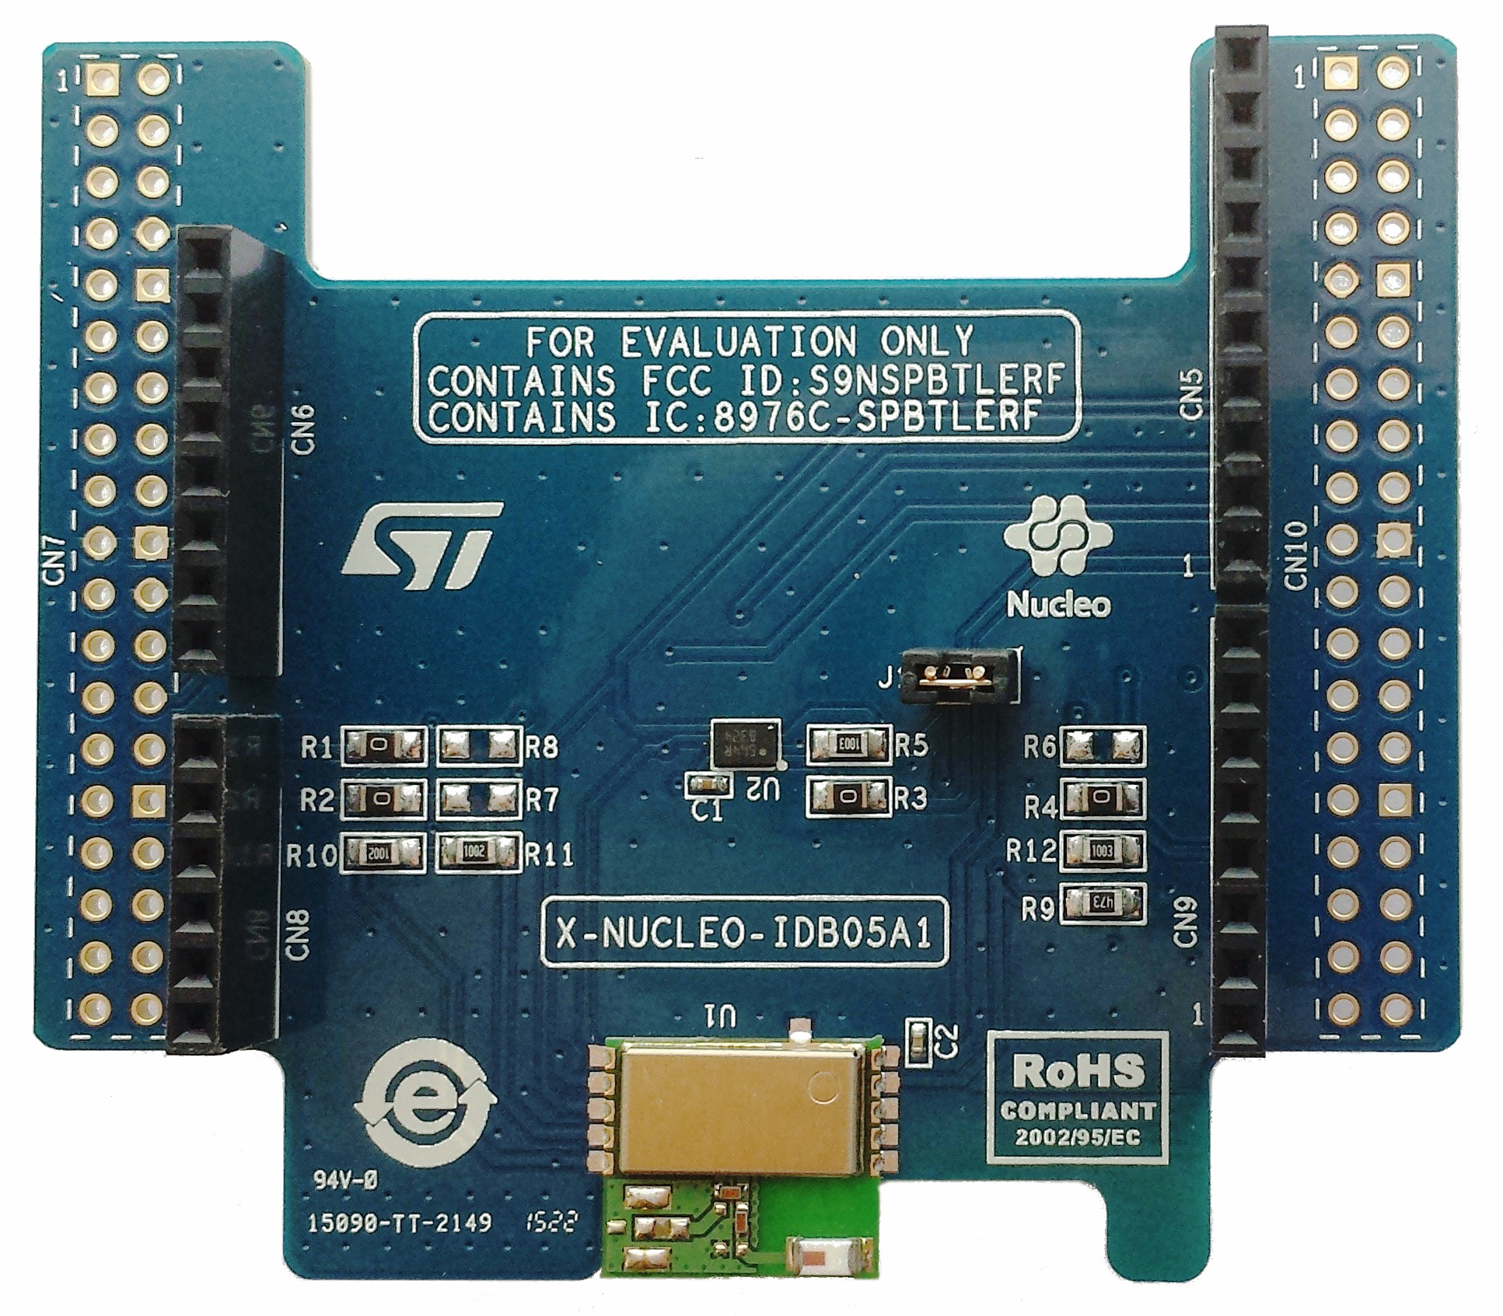
Approach: Bluetooth Module
STMicro SPBTLE-RF
[9]
Notes:
Chaise

Slide 19
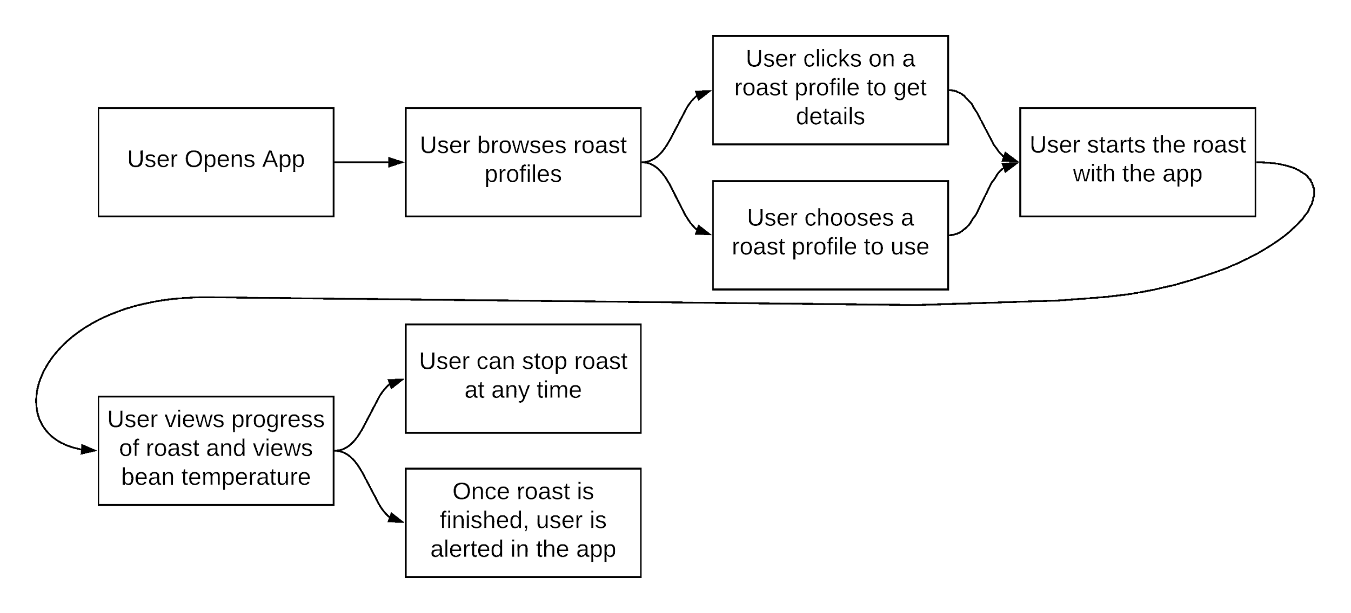
Approach: Smartphone App
Notes:
Smartphone App User Interaction flowchart - Noah

Slide 20
Timeline
Research and spec out parts for prototype - early Sep. 2018
Receive parts and begin testing - late Sep. 2018
Begin to finalize design and present- Nov. 2018
Project Proposal - Summer 2018
Order parts for prototype - mid Sep. 2018
Build and test prototype - Oct. 2018
Final prototype and hardware demo - Dec. 2018
Notes:
Drake

Slide 21
References
[1] “Maxwell House,” Recipes. [Online]. Available: http://www.kraftrecipes.com/maxwell-house. [Accessed: 02-Oct-2018].
[2] “Folgers Coffee - The Best Part of Wakin' Up | Folgers Coffee,” History | Folgers Coffee. [Online]. Available: https://www.folgerscoffee.com/. [Accessed: 02-Oct-2018].
[3] “Single Serve Coffee Makers & K-Cup Pods | Keurig®,” Keurig® Coffee Makers | Best Single Cup Coffee Machines. [Online]. Available: https://www.keurig.com/. [Accessed: 02-Oct-2018].
[4] L. Wallender, “Average Kitchen Size? Well, It's Complicated...,” The Spruce. [Online]. Available: https://www.thespruce.com/average-kitchen-size-1822119. [Accessed: 24 Sep. 2018].
[5] Digikey Electronics, “FAN BLOWER 97X33MM 12VDC WIRE,” Digikey Electronics. [Online]. Available: https://www.digikey.com/products/en?keywords=102-4396-ND. [Accessed: 02-Oct-2018]
Notes:
Everyone

Slide 22
References
[6] StarTech Electronics, “92x25mm Ball Bearing Quiet Computer Case Fan w/ TX3 Connector,” StarTech Electronics. [Online]. Available: https://www.startech.com/Computer-Parts/Fans/Quiet-925cm-Dual-Ball-Bearing-Case-Fan-with-TX3-connector~FAN9X25TX3L. [Accessed: 02-Oct-2018].
[7] “1" x 48" x 24" Mineral Wool/Foil Backing High Temperature Insulation, Density 8#, Dark Brown,” Grainger. [Online]. Available: https://www.grainger.com/product/ROXUL-1-x-48-x-24-Mineral-Wool-Foil-19NE81. [Accessed: 02-Oct-2018].
[8] Adafruit Industries, “Thermocouple Amplifier MAX31855 breakout board (MAX6675 upgrade),” Adafruit Industries blog RSS. [Online]. Available: https://www.adafruit.com/product/269. [Accessed: 02-Oct-2018].
[9] Adafruit Industries, “Thermocouple Type-K Glass Braid Insulated - K” Adafruit Industries blog RSS. [Online]. Available: https://www.adafruit.com/product/270. [Accessed: 02-Oct-2018].
[10] ST Inc, “Bluetooth Low Energy expansion board based on SPBTLE-RF module for STM32 Nucleo,” ST. [Online]. Available: https://www.st.com/en/ecosystems/x-nucleo-idb05a1.html. [Accessed” 02-Oct-2018].
Notes:
Everyone

Slide 23
IntelliRoast
Chaise Farrar · Drake Bolland JR Jamora · Noah Siano Rebecca Siciliano
Notes:
Chaise

